Slide 1


Slide 2
BÀI : HOW MUCH IS TOO MUCH ?

Slide 3



Slide 4
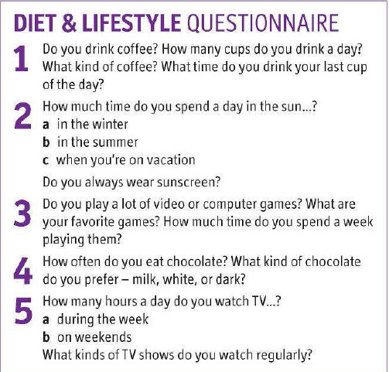

Slide 5




Slide 6



Slide 7
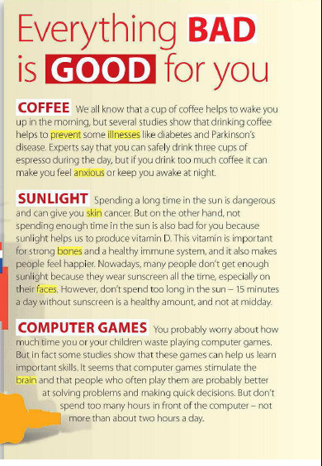

Slide 8
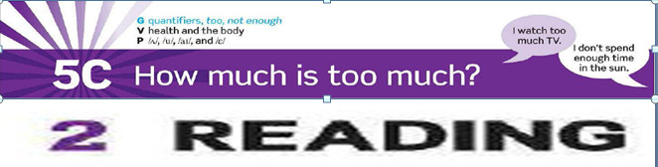

Slide 9
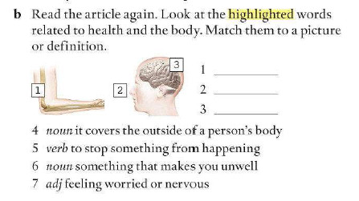

Slide 10


Slide 12
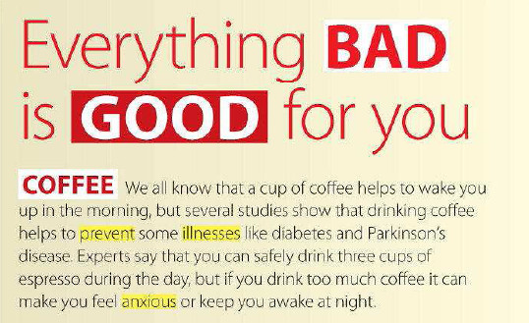

Slide 13
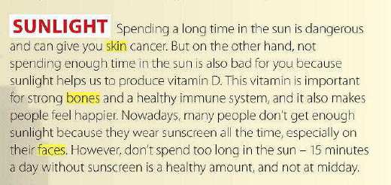

Slide 14
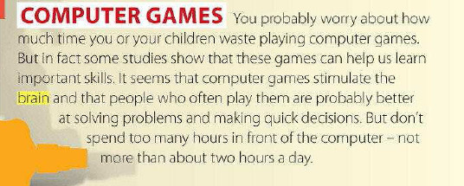

Slide 15


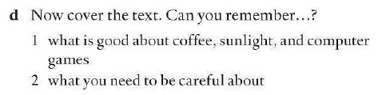

Slide 16


SUNLIGHT
good at

Slide 17






Slide 18



COFFEE
prevent 2 illnesses

Slide 19


COFFEE

Slide 20


SUNLIGHT

Slide 21




+

Slide 22

reducing eyesight
headache

Slide 23


Slide 24
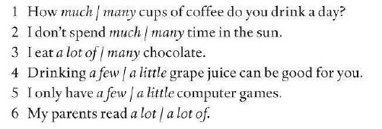







Slide 25




Slide 26
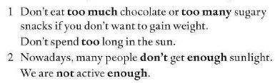


Slide 27

ENOUGH + N
ADJ + ENOUGH
ADJ + ENOUGH + N

Slide 28

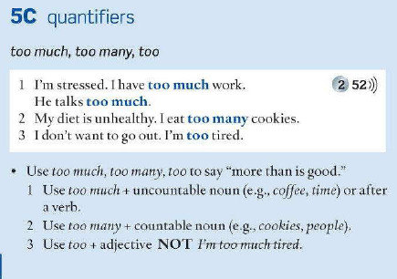

Slide 29
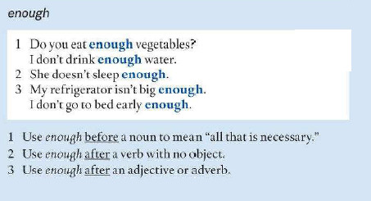






Slide 30





Slide 31



Slide 32


Slide 33
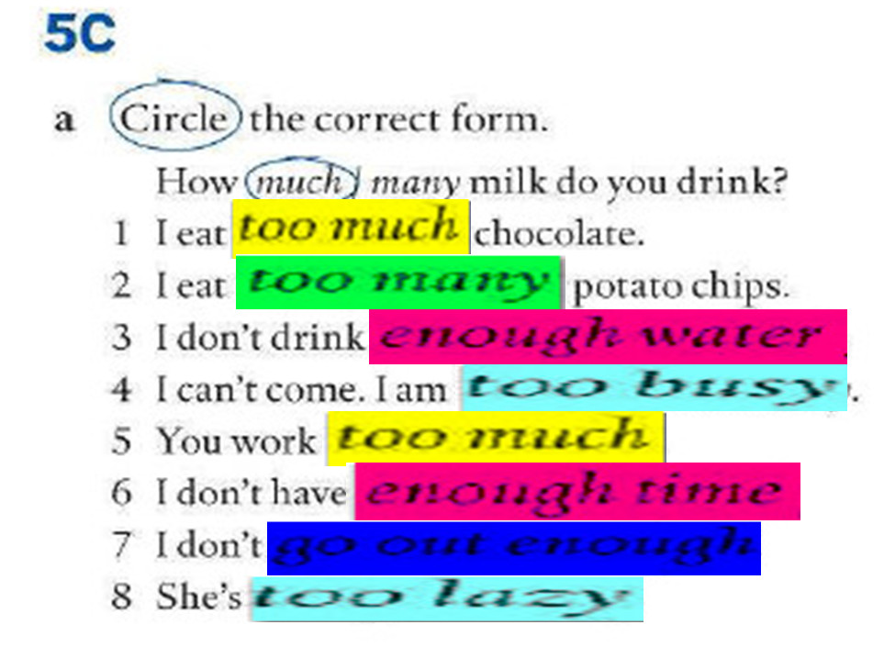

Slide 34
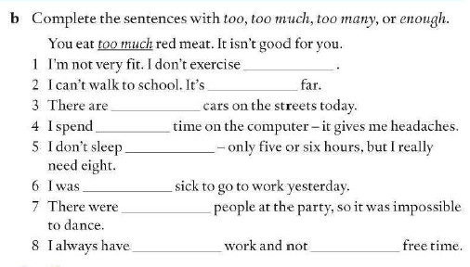



enough
too
too many
enough
too
too many
enough

Slide 35


Slide 36


